Slide 1
Introduction
BoxGame.net
Supervisor:
Lê Thanh Nhân
Members:
Nguyen Tuan Loc - Student1350801
Nguyen Gia Bao - Student1347086
Nguyen Phuoc Hoan - Student1347090
Nguyen Le Thanh Tung – Student1350318
Nguyen Cong Hung – Student987459
Date… Month… Year …...

Slide 2
Content
Introduction
Actual requirements
Requirements of the project
Deployment diagram
Test result
Conclusion and development
Task list

Slide 3
Introduction - Actual requirements
Box Game is a online store that deals with all types of game. They started off with a company in collaboration with Ubisoft and then build up their own establishment. They have different game from different developer, special sale and promotion around the year.
A whole new website with fully functional will let our customers to access the products remotely, allowing us to reach out and expand our customer base. Not only does a website eliminate the need for opening multiple shops in different locations, it can also save money on leaflets and physical advertisements like bill boards and posters.

Slide 4
Introduction - Requirements of the project
Functional
For user :
- Can register a member and manage personal account
- Can view and buy game
- Can search products by name or category
- Can give feedback for products
- Can view their orders and order history
Notes:
Non-functional (how the system works)
Functional (what the system should do)

Slide 5
Introduction - Requirements of the project
Functional
For admin :
Can add (only for boss)/edit admin’s account
Can add/view/edit/delete products
Can view all orders and change status orders
Can view/deactivate/delete user
Notes:
Non-functional (how the system works)
Functional (what the system should do)

Slide 6
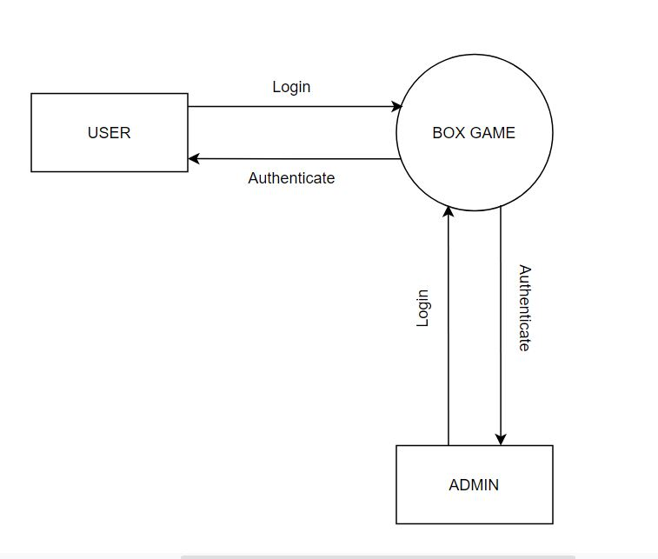
Introduction - Deployment diagram
Data Flow Diagram

Slide 7
Test Result
Functional | Table use | Actor | Status
Login Register Edit account information | Customer | Guest | Done
Search product by name Filter product Feedback product Add to cart product Order product | Product, Customer, Order | User | Done
View order history | Product, Customer, Order | Guest | Done

Slide 8
Test Result
Functional | Table use | Actor | Status
Login | Admin | Admin | Done
Order Management | Order | Admin | Done
Admin’s account Management | Admin | Admin | Done
Product Management | Product | Admin | Done

Slide 9
Task List
No | Member | Contents |  | Table Name | Activity Plan | Date of Preparation of Activity Plan
 |  |  |  |  | Planed Start Date | Actual Start Date | Actual Days | Status
1 | Nguyễn Tuấn Lộc | Admin | Edit Admin account, manage system requirement each game platform, manage type of game | Account_admin, System_requirement, Type | 12/10/2022 | 14/10/2022 | 2 | OK
2
 |  |  |  |  | 16/10/2022 | 16/10/2022 | 1 | OK
3 |  | User | Check system requirement |  | 18/10/2022 | 18/10/2022 | 12 | OK
4 |  |  |  |  | 31/10/2022 | 1/11/2022 | 12 | OK
1 | Nguyễn Gia Bảo | Admin | Order Management, check order status | Cart_master, Cart_details, Store_cart | 12/10/2022 | 14/10/2022 | 10 | OK
2 |  |  |  |  | 01/11/2022 | 1/11/2022 | 10 | OK
3 |  |  |  |  | 10/11/2022 | 10/11/2022 | 10 | OK
4 |  | User | Personal Order Management |  | 10/11/2022 | 10/11/2022 | 5 | OK
1 | Nguyễn Phước Hoàn | Admin | Customer Management | User, Payment | 12/10/2022 | 12/10/2022 | 10 | OK
2 |  |  |  |  | 18/10/2022 | 19/10/2022 | 10 | OK
3 |  | User | Register |  | 31/10/2022 | 31/10/2022 | 10 | OK
4 |  |  | Edit profile, Add payment |  | 5/11/2022 | 5/11/2022 | 5 | OK
1 | Nguyễn Lê Thanh Tùng | Admin | Game Management, Add or Delete Category | Game, Category | 12/10/2022 | 14/10/2022 | 5 | OK
2 |  |  |  |  | 15/10/2022 | 15/10/2022 | 5 | OK
3 |  | User | View, Search Product |  | 01/11/2022 | 31/10/2022 | 5 | N/A
4 |  |  |  |  | 01/11/2022 | 10/11/2022 | 5 | N/A
1 | Nguyễn Công Hùng | Admin | Rating/Comment Management | Rating | 01/10/2022 | 01/10/2022 | N/A | N/A
2 |  |  |  |  | 01/10/2022 | 01/10/2022 | N/A | N/A
3 |  |  |  |  | 01/10/2022 | 01/10/2022 | N/A | N/A
4 |  | User | Send rating, Comment |  | 01/10/2022 | 01/10/2022 | N/A | N/A

Slide 10

Thank You

